Slide 1
AZ-100.1 Module 06: Azure Tips, Tricks, and Tools

Slide 2
Lesson 01: The Azure Portal
Notes:
This module is a set of video walkthroughs that cover helpful ways to navigate the Azure portal as well as a general review of the environment and key tools.
In addition, the module provides videos of important tools that an admin would use in their day to day job, such as PowerShell and the command line interface (CLI).
Depending upon how familiar your students are with Azure, you may opt to ignore this module. Or you could recommend it to students to watch after class if they need a refresher on the basics of the Azure portal, or how to work in the Cloud Shell.
You can definitely consider this as optional material if you need to make adjustments in your time management of a particular class.

Slide 3
Video: Azure Portal Updates
Use the preview functionality to get access to new features that are still in development
portal.azure.azure.com, or preview.portal.azure.com
Switch easily back and forth between different browsers
Ability to search and find what you need quickly, using G+/
Filter and group your resources to narrow down what you're looking for
Multi-select and accessibility improvements
And much more…
Notes:
As a System Administrator you will using the Azure portal all the time. In this lesson, we will work with the Portal and learn some tips and tricks. Even a seasoned professional will find something useful in this lesson.

Slide 4
Video: Keyboard Shortcuts
Ctrl+/ Search blade menu items
G+/ Search resources (global)
G+D Go to the Dashboard
G+A Go to All resources
Notes:
✔ This video and the next ones are courtesy of Michael Crump in the Azure Product team. We are highlighting just a few of the many tips and tricks videos available on his blog. Be sure to check out the complete list.
Azure Tips and Tricks - The Complete List - https://www.michaelcrump.net/azure-tips-and-tricks-complete-list/

Slide 5
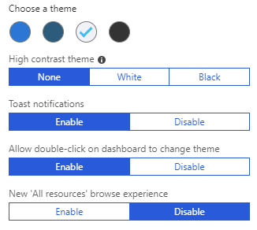
Video: Portal Themes
Choose from a set of predefined themes in the Azure portal
High contrast themes for accessibility
Change your theme with a simple double-click on the dashboard
Notes:
✔ This video and the next ones are courtesy of Michael Crump in the Azure Product team. We are highlighting just a few of the many tips and tricks videos available on his blog. Be sure to check out the complete list.
Azure Tips and Tricks - The Complete List - https://www.michaelcrump.net/azure-tips-and-tricks-complete-list/

Slide 6
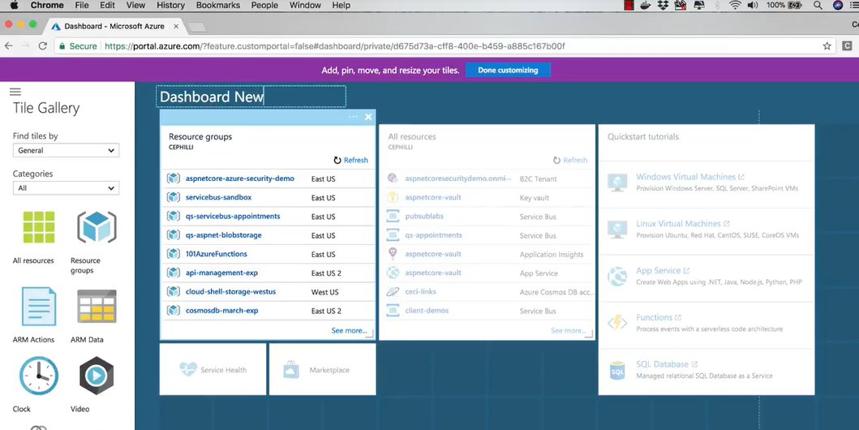
Video: Customize the Dashboard
Notes:
✔ This video and the next ones are courtesy of Michael Crump in the Azure Product team. We are highlighting just a few of the many tips and tricks videos available on his blog. Be sure to check out the complete list.
Azure Tips and Tricks - The Complete List - https://www.michaelcrump.net/azure-tips-and-tricks-complete-list/

Slide 7
Video: Dashboard Favorites
Useful tips and tricks for working in Azure
Add and reorder favorites in the Azure dashboard
Make your most frequently used services easier to find
Notes:
✔️ As you have time, check out other Tips and Tricks videos.
Azure Tips and Tricks - The Complete List - https://www.michaelcrump.net/azure-tips-and-tricks-complete-list/

Slide 8
Lesson 02: Azure Tools and Environment

Slide 9
Video: Cloud Shell
Notes:
For more information, you can see:
Overview of Azure Cloud Shell - https://docs.microsoft.com/en-us/azure/cloud-shell/overview?view=azurermps-6.5.0

Slide 10
Video: Azure CLI
Command-line tool alongside Azure PowerShell
Focused on Mac/Linux/BASH/cmd.exe
Simple to automate
Easy to learn
Notes:
For more information, you can see:
Get started with Azure CLI 2.0 - https://docs.microsoft.com/en-us/cli/azure/get-started-with-azure-cli?view=azure-cli-latest

Slide 11
Video: Azure PowerShell
Set of cmdlets that use Azure Resource Manager to manage resources
Use locally or with the Azure Cloud Shell
Update Azure PowerShell installation with Update-Module
Use multiple versions of Azure PowerShell if needed
Install an older version
# Install version 1.2.9 of Azure PowerShell Install-Module -Name AzureRM -RequiredVersion 1.2.9
Load a different version (Latest version provided by default when loading)
# load version 1.2.9 of Azure PowerShell Import-Module -Name AzureRM -RequiredVersion 1.2.9
Notes:
For more information, you can see:
Azure PowerShell - https://docs.microsoft.com/en-us/powershell/azure/overview?view=azurermps-6.5.0

Slide 12
Video: Azure PowerShell Cross-Platform
Run PowerShell on Linux and Mac systems
PowerShell is now PowerShell Core 6
Built on .NET, PowerShell modules converted to .Net Core

Slide 13
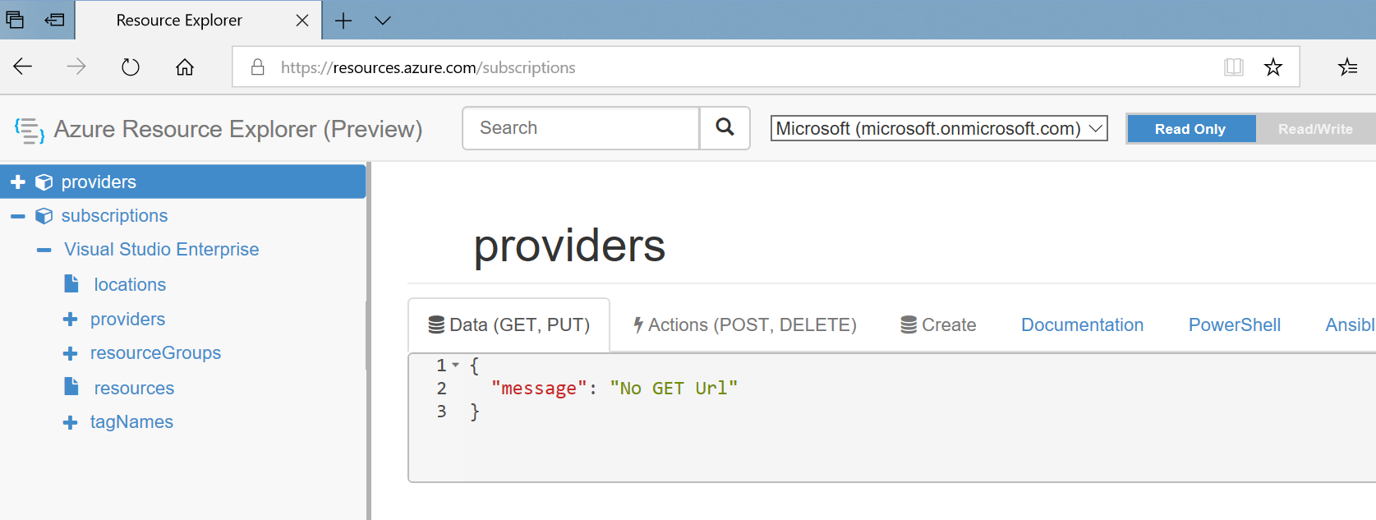
Video: Resource Explorer
Standalone app for working with Azure Storage data on Windows, Mac OS, and Linux
Connect and manage your storage accounts
Notes:
There are no module review questions for this module.

